Slide 1

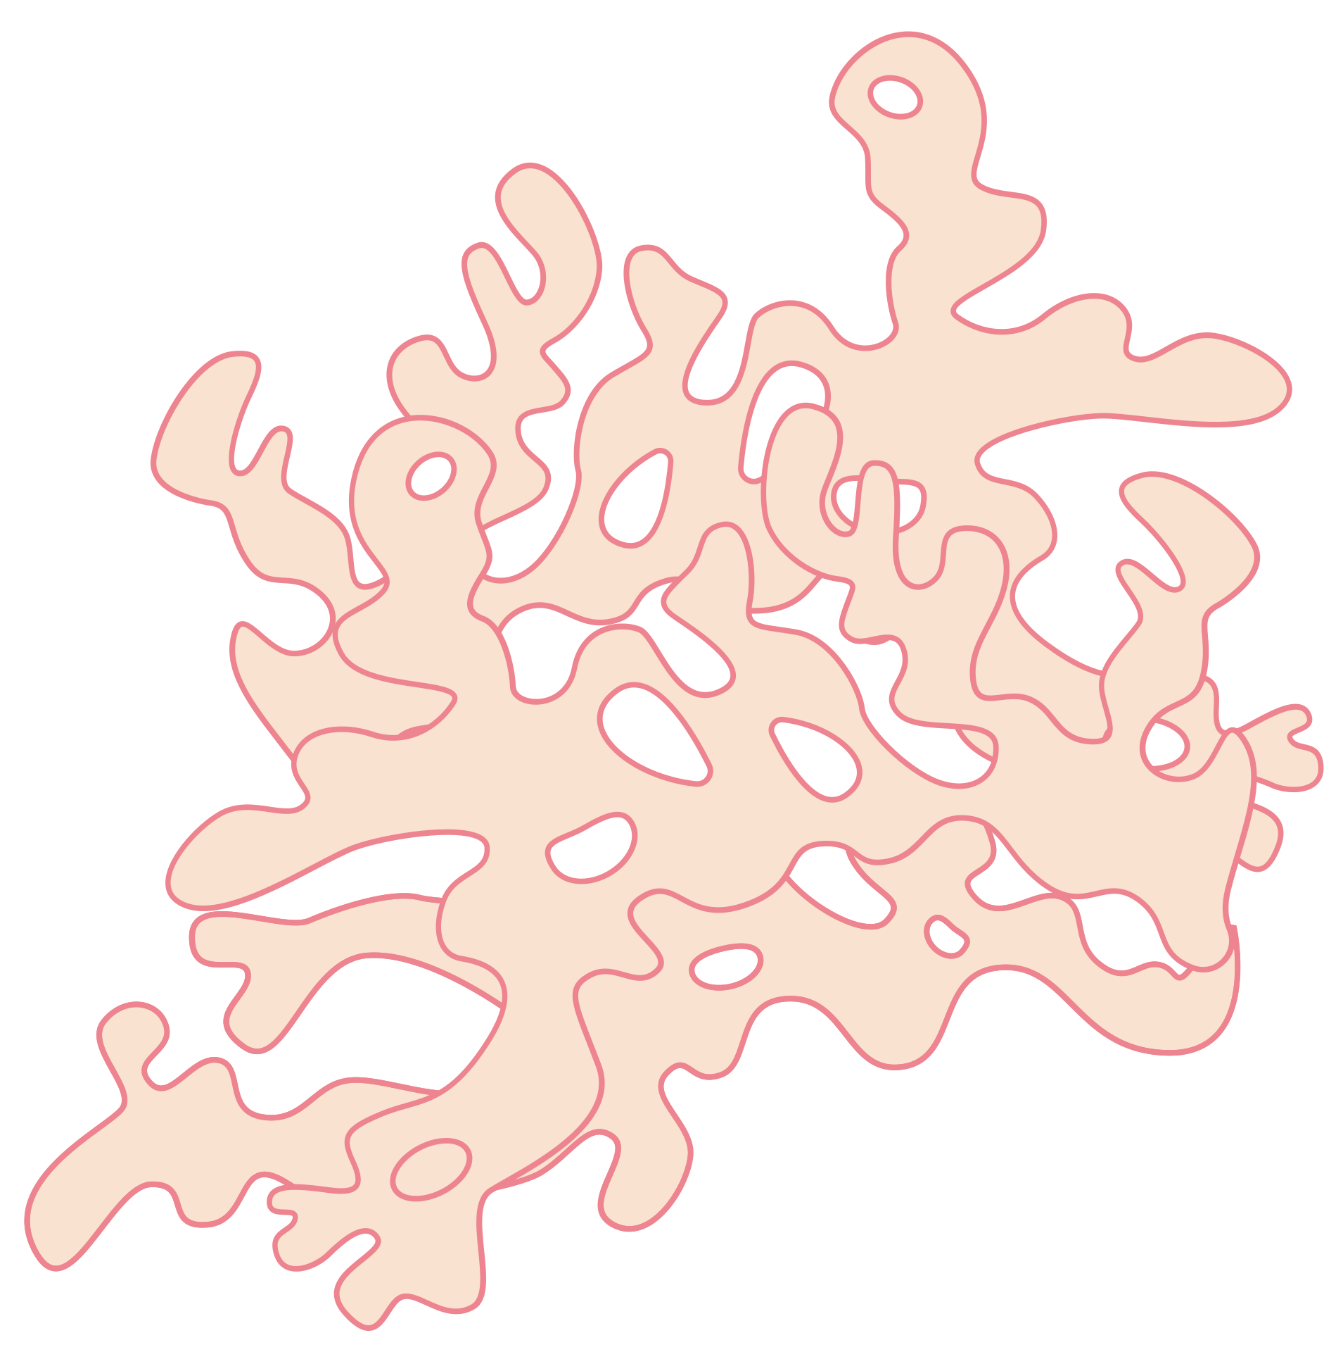





Donate Organs
Save Lives
ORGAN
BANK
Presented By :
DONA JINCE
MAC23MCA-2024
Project Guide:
NISHA MARKOSE

Slide 2
Introduction
The Organ Bank is an android application designed to streamline the process of organ donation and transplantation.
This platform connects donors, receipients, and hospitals through a centralized database, facilitating efficient organ allocation and management.

Slide 3


INTRODUCTION
FUNCTIONALITIES
DONATE ORGANS
SAVE LIVES
OBJECTIVES
TECHNOLOGY
CONTENTS
ACTORS
RELEVANCE

Slide 4

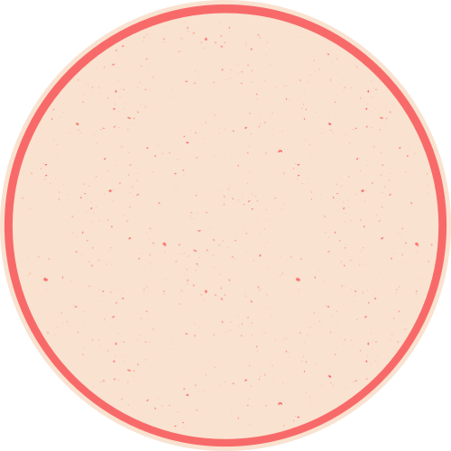

Objectives
Encourage Organ Donation:
Simplify registration to motivate individuals to donate organs and raise awareness about its importance.
Transparency:
Build trust through a transparent organ allocation process and real-time updates.
Centralized Management:
Provide a single platform to connect donors, recipients, and hospitals for effective organ donation and transplantation.
Automated Matching:
Use compatibility criteria (e.g., blood type, urgency, organ type) to ensure fair and efficient organ allocation.
Real-Time Notifications:
Notify donors, recipients, and hospitals promptly about matches and updates in the system.

Slide 5



FUNCTIONALITIES
User Management:Verify and approve registrations of donors, recipients, and hospitals.
Data Validation:Ensure that all medical records and personal information submitted by users are accurate and complete.
System Monitoring:Monitor organ allocation processes to maintain fairness and transparency.
Database Maintenance:Manage and update the central database, including adding or removing records as necessary.
ADMIN
Reports and Analytics:Generate reports on organ availability, transplantation statistics, and donor-recipient trends.
Resolve Issues:Address any disputes or technical issues arising during system use.

Slide 6
FUNCTIONALITIES
Registration:Provide personal details, medical history, and the organs they wish to donate.
Profile Management:Update their information, such as address or medical status, as needed.
DONORS
Consent:Confirm their willingness to donate specific organs at the time of registration.
Notification Handling:Receive notifications if their donation is eligible for a recipient match or for updates regarding their donation status.

Slide 7
FUNCTIONALITIES
Registration:Submit a request for specific organs, along with their medical details and eligibility documents.
Profile Management:Update their health records or change organ request preferences if necessary.
RECEIPIENTS
Monitoring:Track the status of their request and receive notifications when a matching organ becomes available.
Medical Coordination:
Collaborate with their selected hospital to proceed with the transplantation process upon organ allocation.

Slide 8
FUNCTIONALITIES
Registration:Provide hospital details, including location, contact information, and areas of specialization.
Request Management:Submit requests for organs on behalf of their patients, specifying the type and urgency.
HOSPITALS
Medical Verification:Verify the compatibility of a donated organ with a recipient before proceeding with transplantation.
Procedure Updates:Update the system after successful transplants, including recipient recovery status and organ usage.

Slide 9
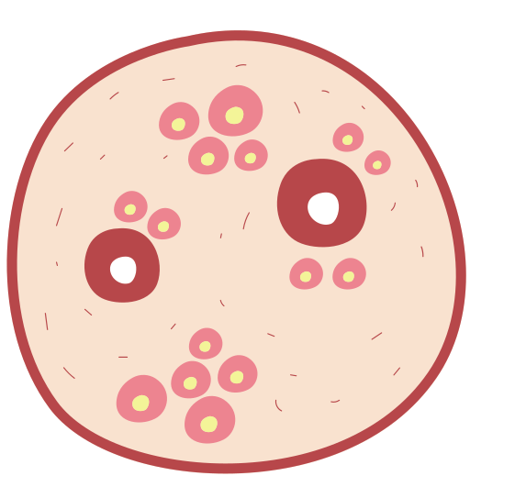
FRONTEND
BACKEND
FLUTTER
NODE JS
TECHNOLOGY
DATABASE
MONGODB

Slide 10



RELEVANCE
•Address the challenge of organ shortages and the inefficiencies in existing manual processes.
•By automating donor-recipient matching, providing real-time notifications, and maintaining secure medical records, the system reduces wait times and maximizes the utilization of available organs.
•it encourages more individuals to register as donors by ensuring transparency and building trust in the process.

Slide 11

EXISTING SYSTEM
Reliance on manual processes for organ donation and matching.
Delays in matching organs, causing long waiting times.
Communication gaps between hospitals, donors, and recipients.
No automation for compatibility checks or organ allocation.
Lack of transparency in organ matching and approval processes.

Slide 12
PROPOSED SYSTEM
Centralized database for donors, recipients, and hospitals.
Real-time notifications for organ match approvals and updates.
Seamless communication between admin, hospitals, donors, and recipients.
Efficient scheduling and management of compatibility tests.
Enhanced decision-making through reports and analytics.

Slide 13
ACTORS
ADMIN
RECEIPIENT
The admin oversees the entire system to ensure its smooth operation, ethical functioning, and data integrity.
Recipients are patients who need organ transplants.
DONORS
HOSPITAL
Donors are individuals who wish to donate their organs, either during their lifetime or posthumously.
Hospitals are authorized medical institutions that perform organ transplantation surgeries.

Slide 14
Roles
&
Responsibilities

Slide 15
Admin
·Verify donor, recipient, and hospital registrations.
·Oversees the automated organ matching system and reviews potential matches.
·Notifies donors, recipients, and hospitals about approved matches.
·Tracks organ availability and generates detailed reports.
·Monitors transplantation results and oversees feedback submissions.

Slide 16
Donor
·Registers with the system, providing consent for organ donation.
·Updates personal details and organ donation preferences.
·Receives notifications from the admin and hospital regarding matches, compatibility tests, and transplantation schedules.
·Provides feedback about the system and hospital services.

Slide 17
Receipient
·Registers with the system, requesting organ transplants.
·Updates personal details and organ requirements.
·Receives notifications about organ matches, compatibility tests, and transplantation schedules.
·Tracks organ match statuses and compatibility test results.
·Provides feedback about the system and hospital services.

Slide 18
Hospital
·Registers with the system and manages hospital-related data.
·Conducts compatibility tests for matched donors and recipients.
·Schedules and carries out transplantation procedures.
·Notifies donors and recipients about test and transplantation schedules.
·Updates the system with test results and transplantation outcomes.
·Provides feedback on the organ bank system.

Slide 19
Module
Description

Slide 20
USER MANAGEMENT
Donors, Recipients, and Hospitals can register by providing necessary details such as personal information and contact details.
Admin reviews the registration details.
Approves or rejects registrations based on validity and authenticity of the provided information.
Sends approval/rejection mails to the respective users.
Donors and Recipients can update their profiles after approval.

Slide 21
ORGAN MATCHING MODULE
Automatically matches registered donors and recipients based on compatibility factors such as blood group, organ type.
Adds successful matches to the Matched Organs Table, awaiting admin approval.
Admin approves or rejects the matches, and mails are sent to the donor, recipient, and hospital.

Slide 22
COMPATIBILITY TESTING MODULE
Hospitals schedule onsite compatibility tests for approved matches.
Updates the system with test results (pass/fail).
If compatibility tests fail: The corresponding match is removed from the Matched Organs Table and notifications are sent to the donor, recipient, and admin.

Slide 23
FEEDBACK AND COMPLAINT MANAGEMENT MODULE
Donors, Recipients, and Hospitals can submit feedback on their experiences, system usability, and hospital services.
Feedback is visible to the Admin for system improvement.
Donors and Recipients can raise complaints about hospital services, compatibility testing, or delays in processes.
Hospitals can report any issues related to the system or donor/recipient cooperation.
Admin tracks complaints and resolves them promptly, with updates visible to the complainant.

Slide 24
REPORT MANAGEMENT MODULE
Admin generates reports on:
o Transplantation outcomes and success rates.

Slide 25
TRANSPLANTATION MANAGEMENT MODULE
Hospitals conduct transplantation procedures after successful compatibility tests.
Updates the system with transplantation outcomes (success or failure).
Notifications are sent to Admin, Donors, and Recipients about the procedure status.

Slide 26
UML
DIAGRAMS

Slide 27
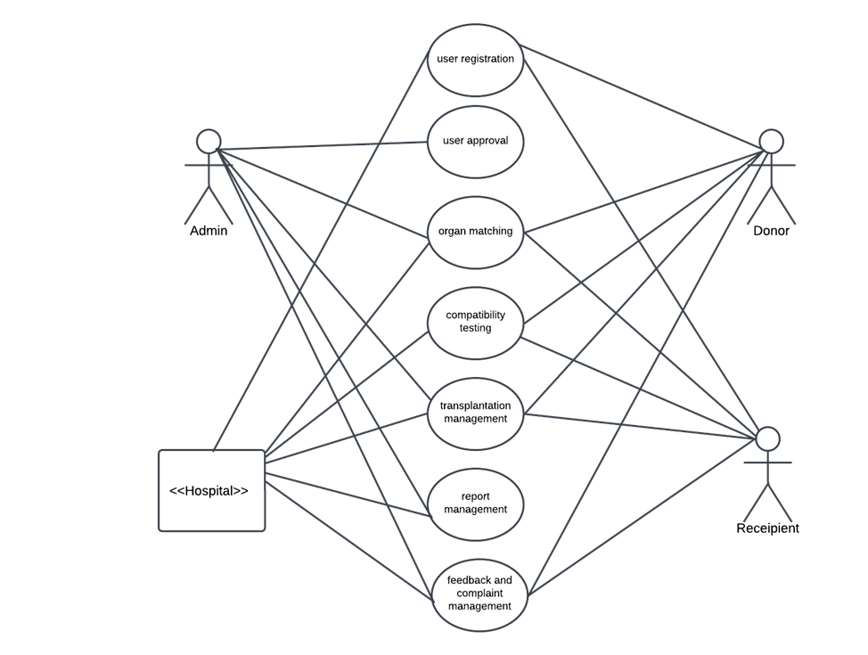
U
S
E
C
A
S
E

Slide 28
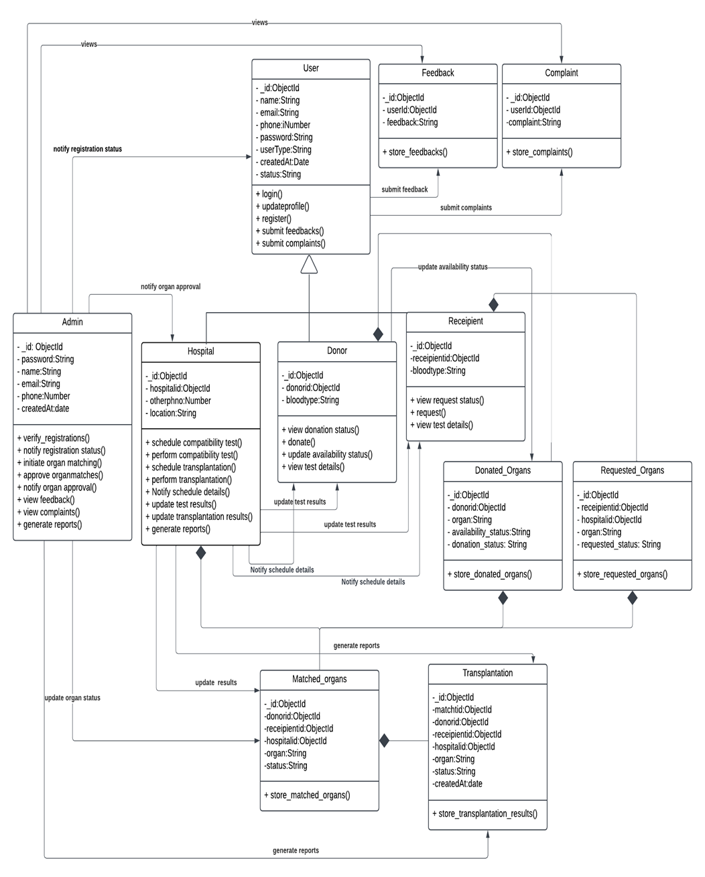
CLASS
DIAGRAM

Slide 29
SEQUENCE
DIAGRAMS

Slide 30
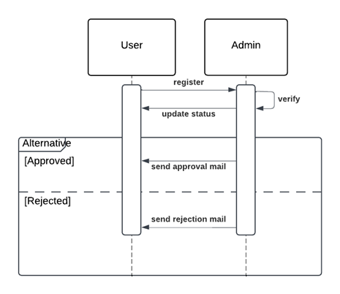
USER
REGISTRATION

Slide 31
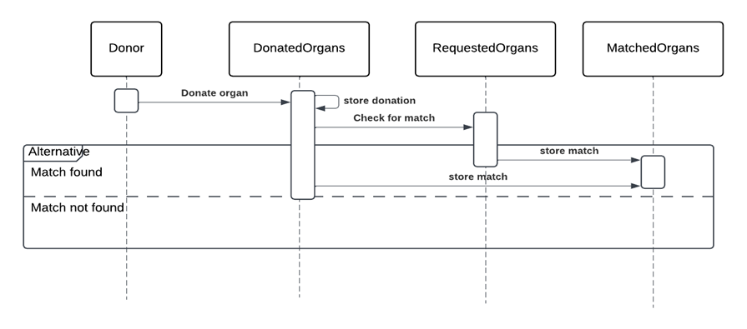
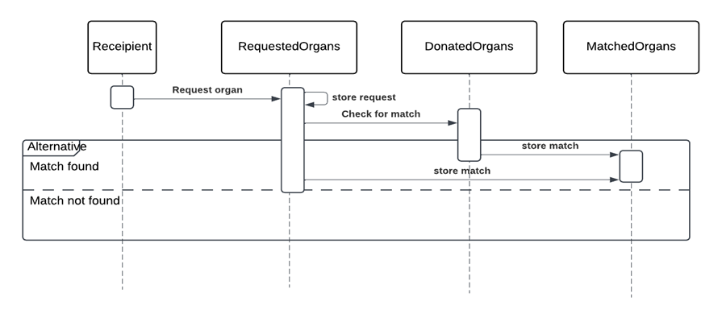
ORGAN
MATCHING

Slide 32
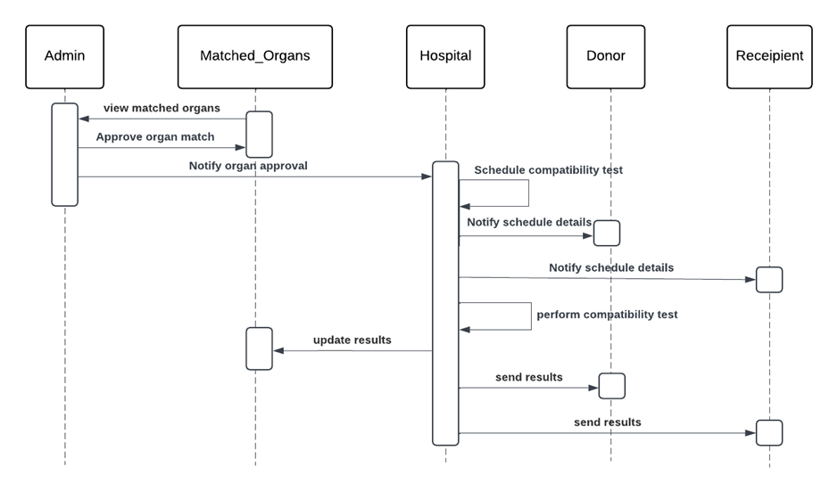
Compatibility
Test

Slide 33
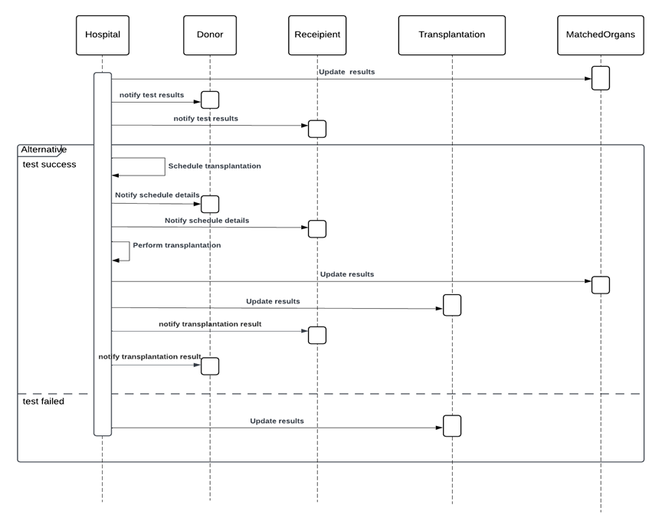
Transplantation
Module

Slide 34
ACTIVITY
DIAGRAMS

Slide 35
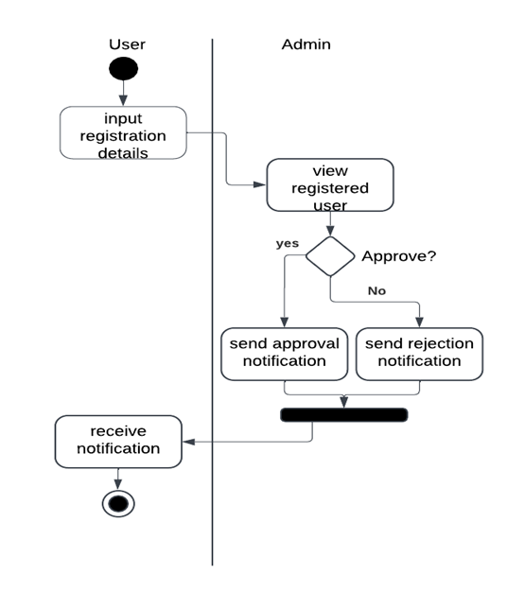
USER
REGISTRATION

Slide 36
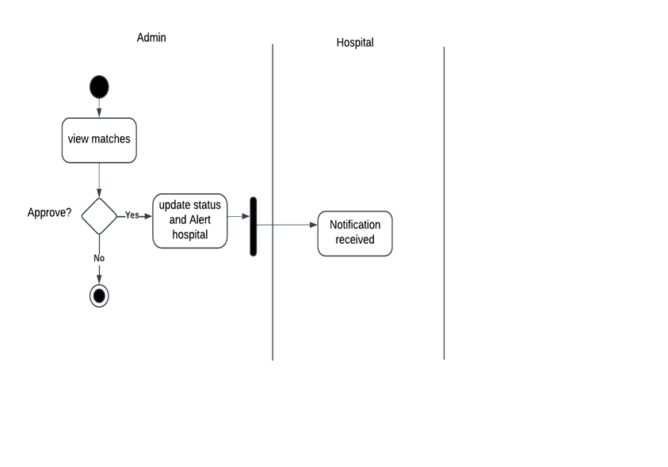
MATCH
APPROVAL

Slide 37
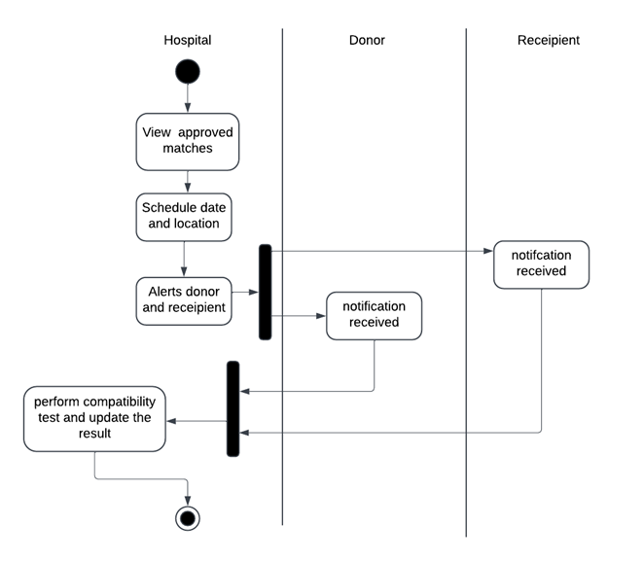
Compatibility
Test

Slide 38
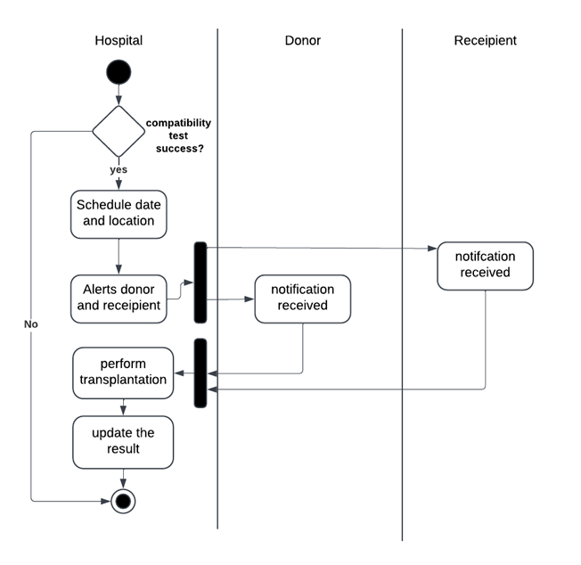
Transplantation
Module

Slide 39
BUSINESS
RULES

Slide 40
• Registrations for Donors, Recipients, and Hospitals must be reviewed and approved by the Admin before granting access to the system.
• Donation Consent can be revoked at any time before a match is approved by the Admin.
• Priority will be given based on medical urgency, compatibility, and waiting time.
• Matches must be reviewed and approved by the Admin before proceeding to compatibil ity tests.

Slide 41
• Only verified hospitals can perform compatibility tests and transplantation procedures.
• Admin must review all registrations (Donors, Recipients, Hospitals) within 24–48 hours of submission. • Complaints must be addressed by the Admin

Slide 42
Feasibility Study

Slide 43
Technical Feasibility
Frontend: Flutter ensures seamless cross-platform compatibility; Dart provides responsive UI and smooth performance.
Backend: Node.js enables fast, scalable server-side logic and organ matching algorithms via RESTful APIs.
Database: MongoDB offers flexible, scalable, and efficient data management for donor/recipient profiles and transaction logs.

Slide 44
Ecnomic Feasibility
Open-source technologies (Flutter, Node.js, MongoDB) reduce licensing costs.
Automation lowers administrative expenses and saves time.
Initial investment is justified by long-term cost optimization.

Slide 45
Operational Feasibility
Intuitive UI ensures a consistent user experience across mobile and web.
Automates organ matching.
Enhances trust and transparency through notifications and secure data management.

Slide 46
SYSTEM ENVIRONMENT

Slide 47
Hardware Environment
1.Client Devices:
a.Smartphones and PCs for donors, recipients, and hospital staff.
b.Minimum: Dual-core processor, 4GB RAM, 500MB storage.
2.Server Requirements:
a.High-performance server with the following:
i. Quad-core processor or higher.
ii. 16GB RAM minimum.
iii. 1TB storage with SSD for fast data access.
iv. Reliable internet connectivity for seamless operations.
3.Networking:
a.Secure, high-speed network for communication between client devices and the server.

Slide 48
Software Environment
1.Frontend: Flutter (Dart Language) for cross-platform mobile and web application development.
2.Backend: Node.js for efficient server-side logic and API handling.
3.Database: MongoDB for scalable, NoSQL-based data management.
4.Server OS: Linux (Ubuntu) for high performance, reliability, and cost-effectiveness.
5.Development Tools:
·Android Studio for Flutter development.
·VS Code for backend development.
·Postman for API testing.
6.APIs & Frameworks: RESTful APIs for frontend-backend communication.

Slide 49
PAPERS

Slide 50
Blockchain-Based Management for Organ Donation and Transplantation (Diana Hawashin et al.)
Challenges in Traditional Systems:
Manual processing delays
Data manipulation risks
Lack of real-time tracking
Proposed Solution:
Structured donor-recipient matching
Automated organ removal, transportation, and transplantation
Real-time updates for secure and transparent allocation
Key Impact on Organ Bank Project:
Automated scheduling & donor-recipient matching
Real-time notifications to stakeholders
Minimizing delays & improving trust

Slide 51
Organ Donation Decentralized Application Using Blockchain Technology (Lama Abdulwahab Dajim et al.)
Key Focus Areas:
Automated organ donation platform for efficient data handling
Ensures data integrity, privacy, and transparency
Standardized allocation criteria & real-time hospital coordination
Functionalities in Organ Bank Project:
Automated donor-recipient matching to reduce inefficiencies
Real-time organ availability updates
Streamlined communication between hospitals and recipients

Slide 52
MongoDB Integration with Python and Node.js, Express.js (Santi Kumari Behera et al.)
MongoDB as a NoSQL Solution: Handles semi-structured donor-recipient data efficiently.
Integration with Node.js:
Mongoose ORM for Node.js.
RESTful APIs enable real-time database interactions.
Performance & Security:
Authentication, encryption, and access control for data security.
Relevance to Organ Bank: Scalable database for fast donor-recipient matching & real-time updates.

Slide 53
Proposals
Implement automated organ matching using MongoDB queries based on blood type & compatibility.
Integrate real-time scheduling for compatibility tests and transplant updates.
Enable automated email notifications for hospitals, donors, and recipients.
Enhance database security with authentication, encryption, and role-based access control.
Use Flutter for a seamless user interface and Node.js for efficient backend processing.

Slide 54
UI
DESIGNS

Slide 55
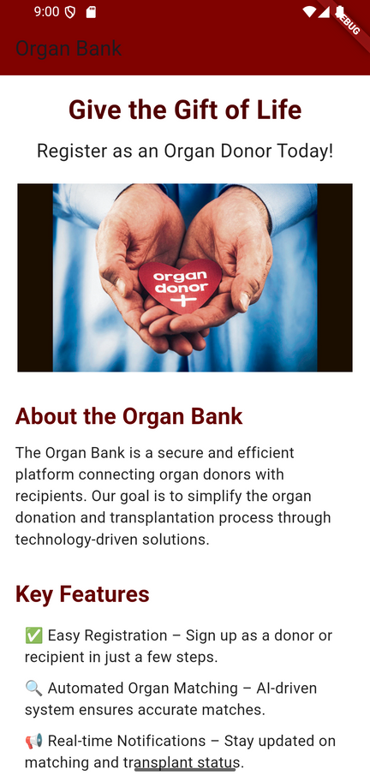
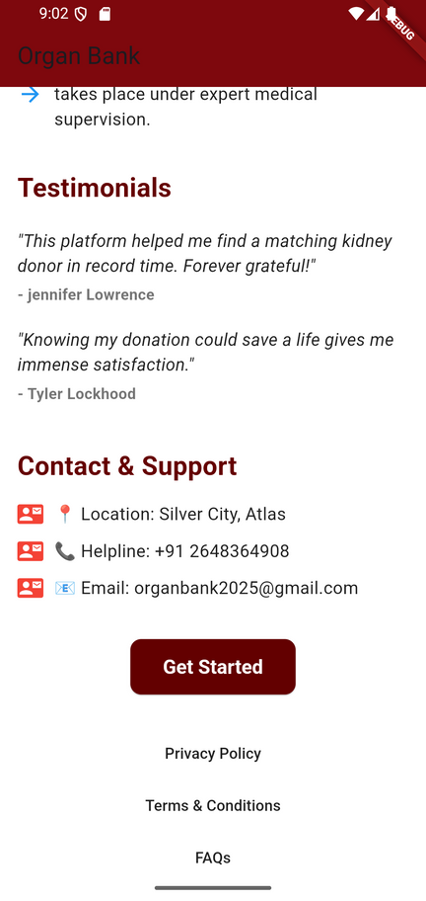
Home Page

Slide 56
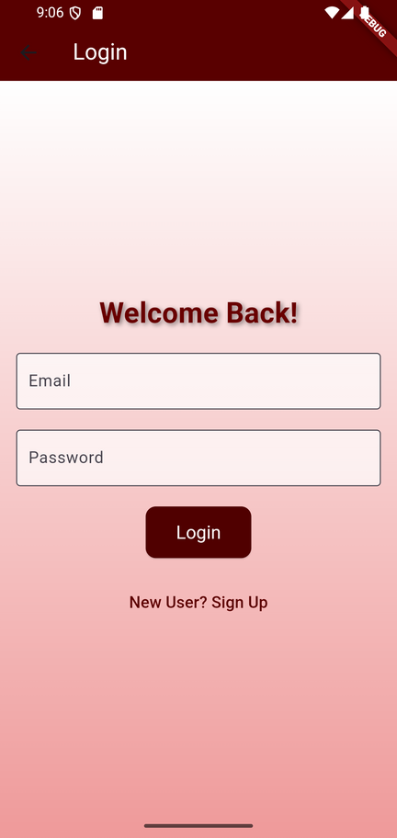
Login
Page

Slide 57
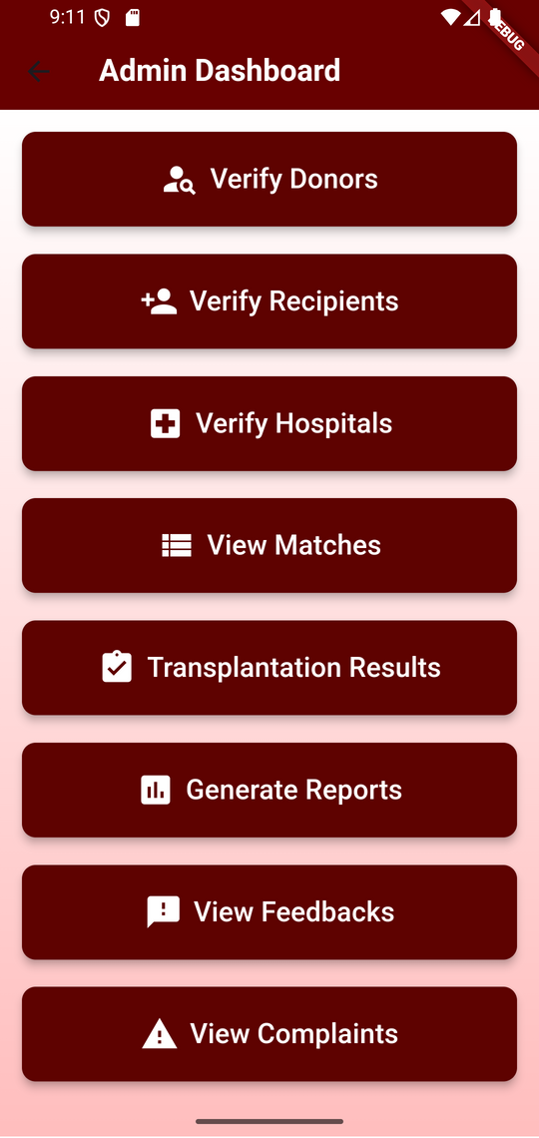
Admin
Dashboard

Slide 58
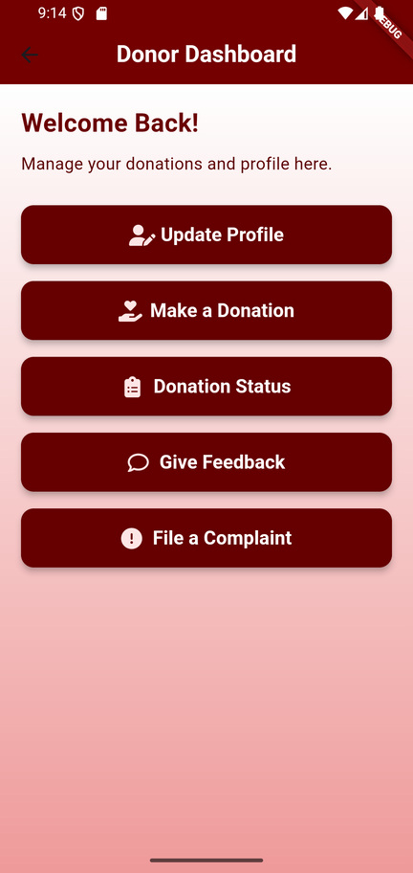
Donor
Dashboard

Slide 59
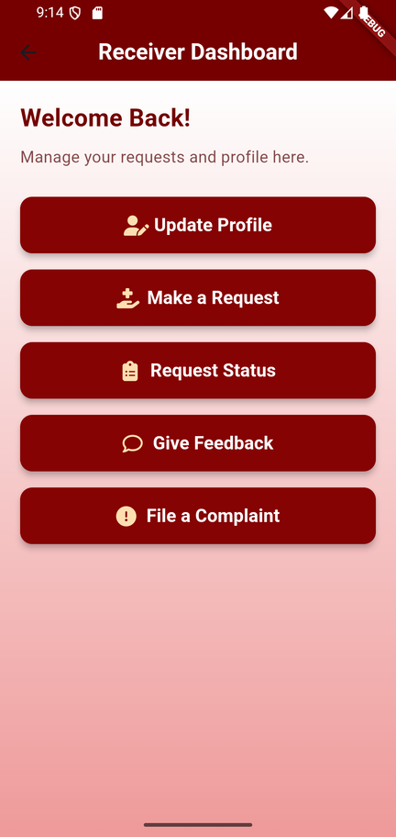
Receipient
Dashboard

Slide 60
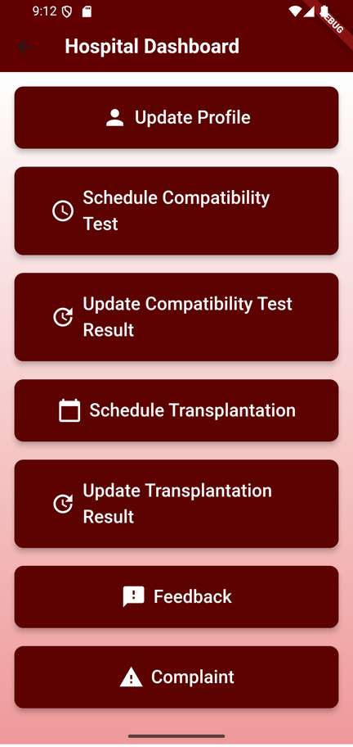
Hospital
Dashboard

Slide 61
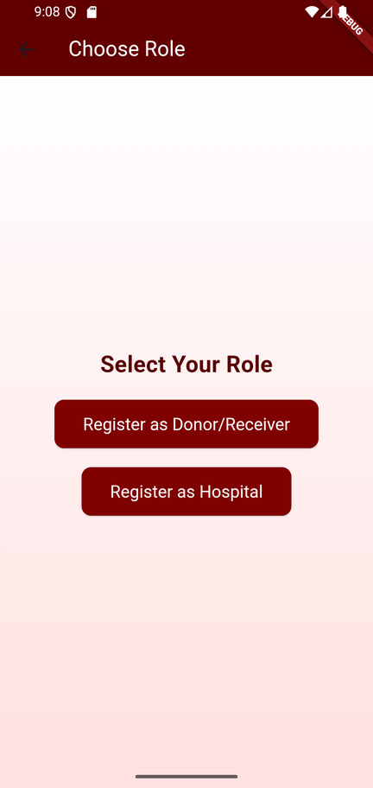
User Registration

Slide 62
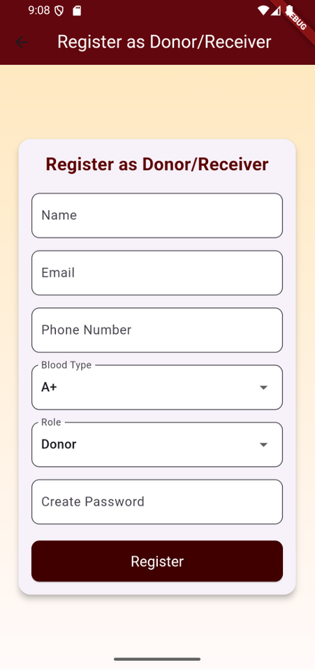
Donor/Receipient Registration

Slide 63
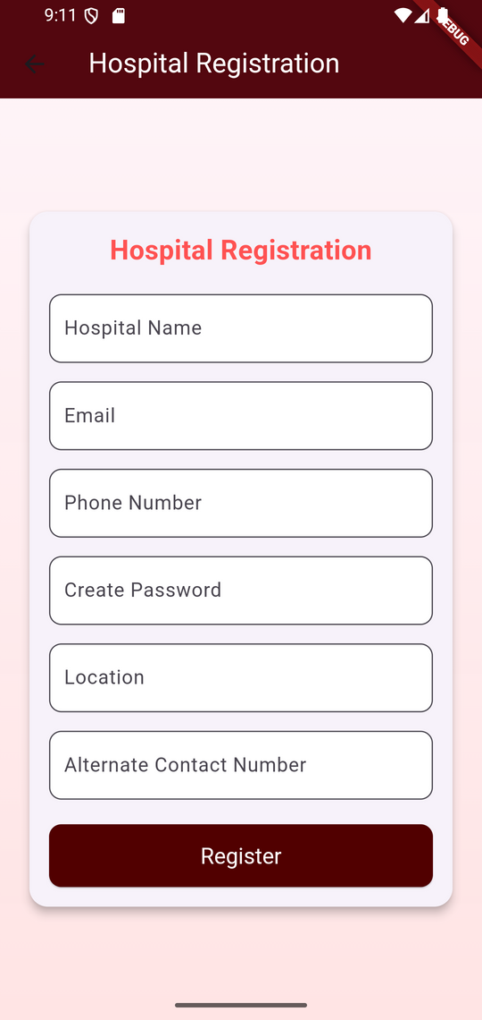
Hospital Registration

Slide 64
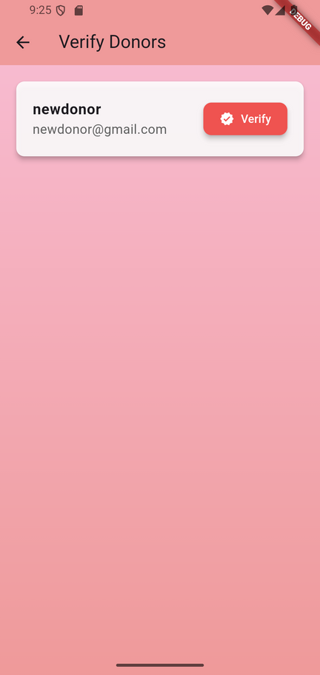
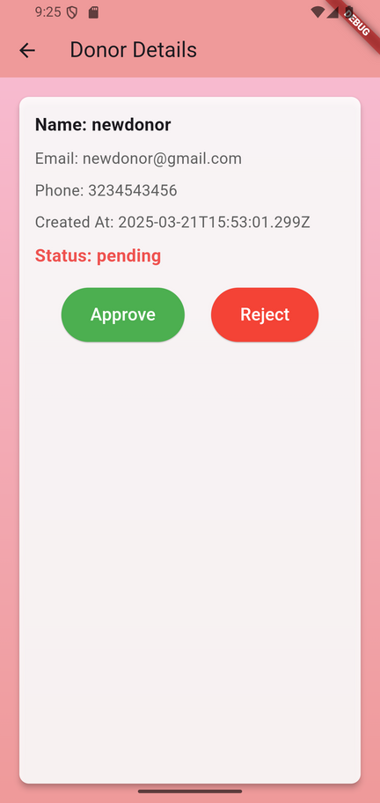
Verify Donor

Slide 65
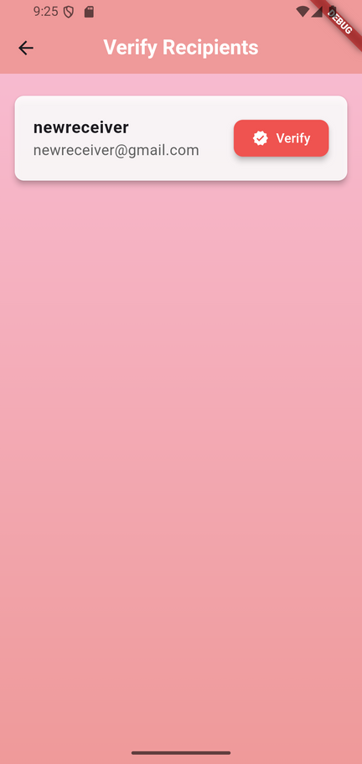
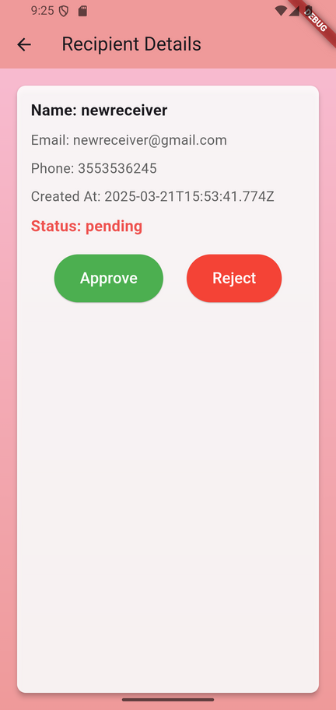
Verify Receipient

Slide 66
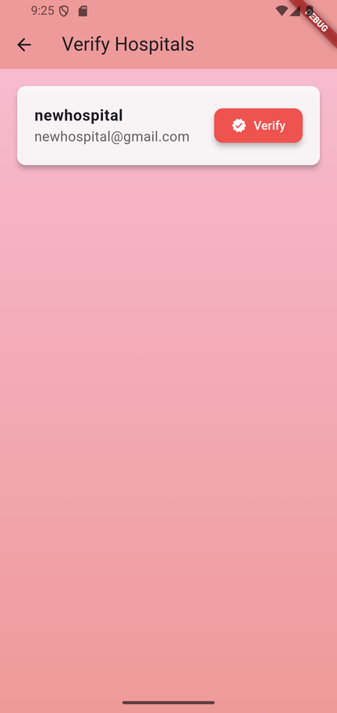
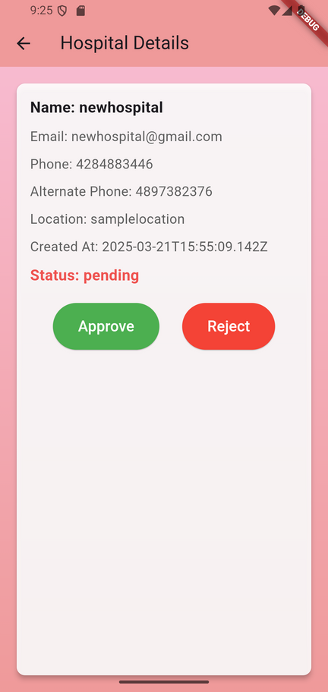
Verify Hospital

Slide 67
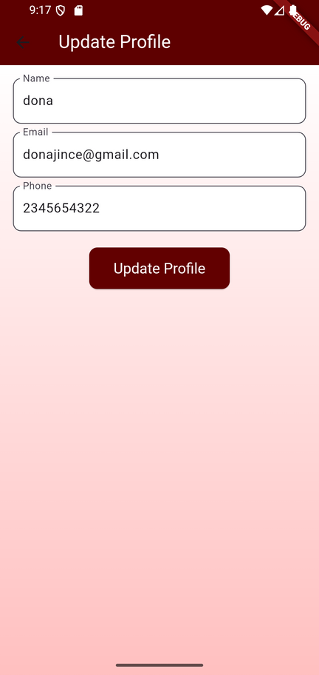
Update Donor/Receipient Profile

Slide 68
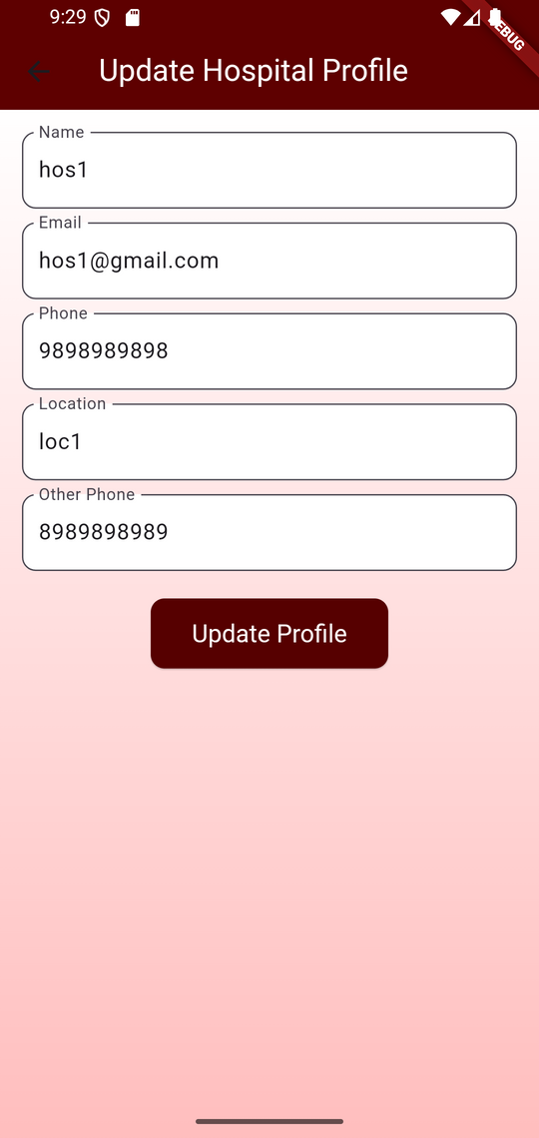
Update Hospital Profile

Slide 69
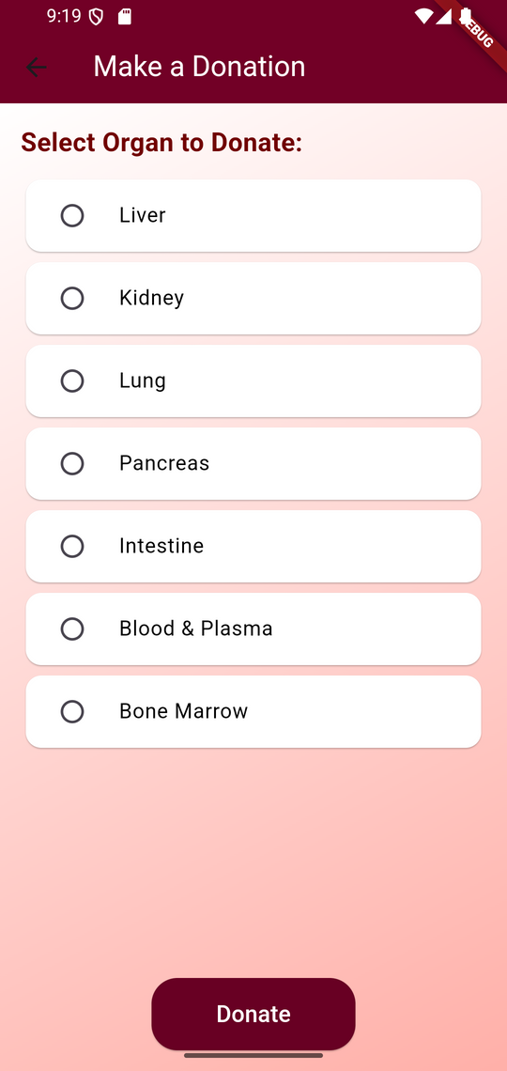
Make Donations

Slide 70
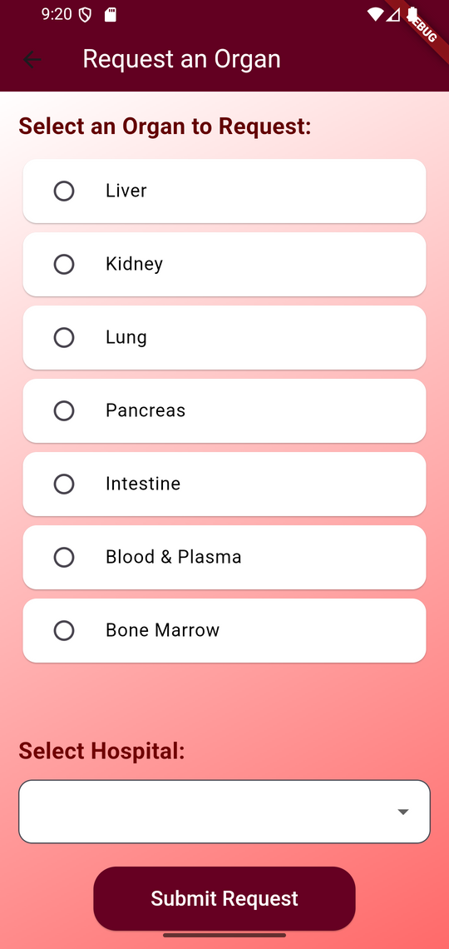
Make Requests

Slide 71
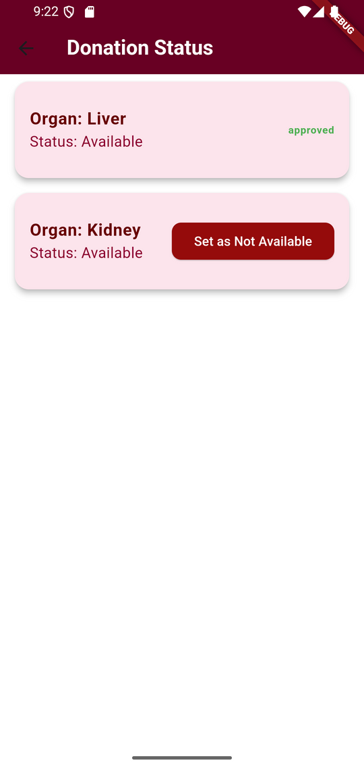
View Donation Status

Slide 72
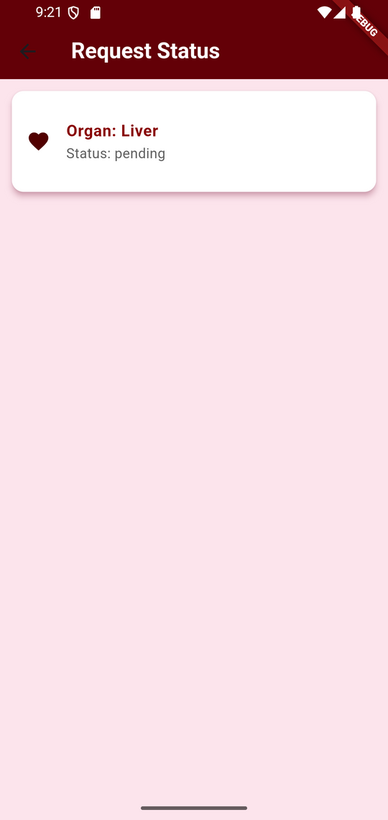
View Request Status

Slide 73
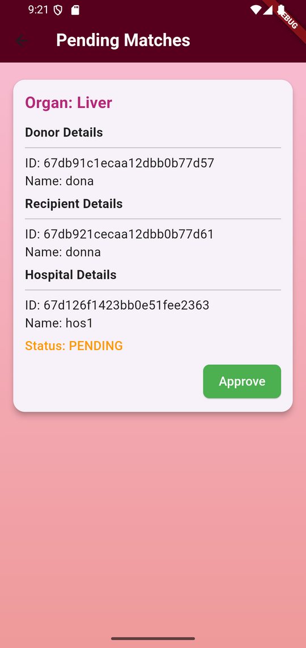
View Matches

Slide 74
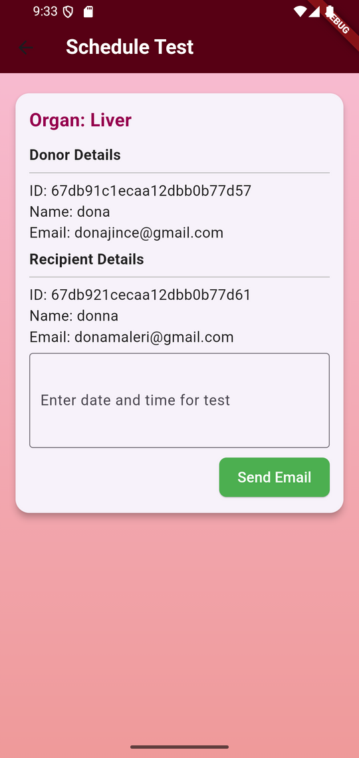
Schedule Compatibility Test

Slide 75
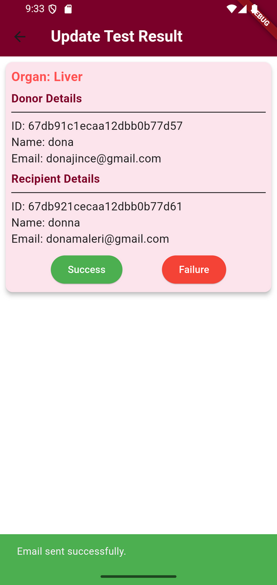
Update Compatibility test result

Slide 76
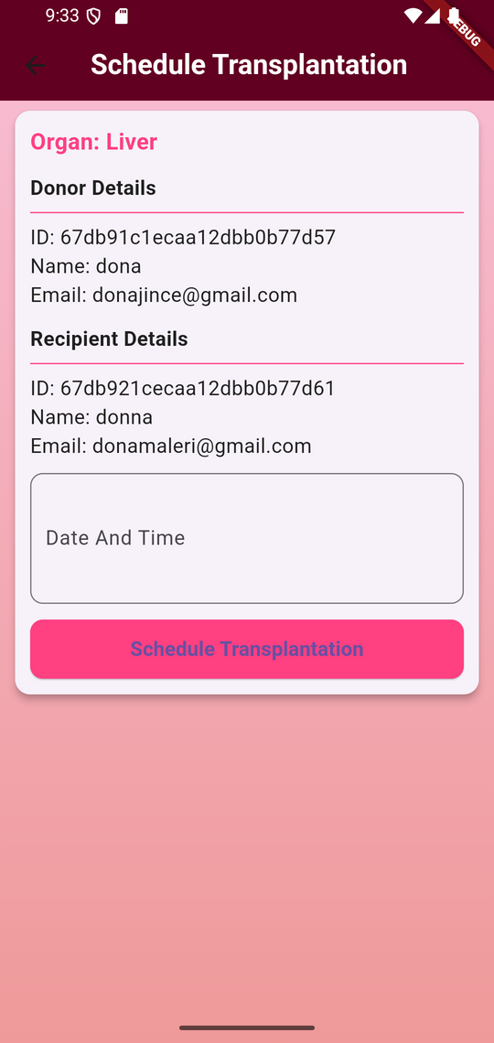
Schedule Transplantation

Slide 77
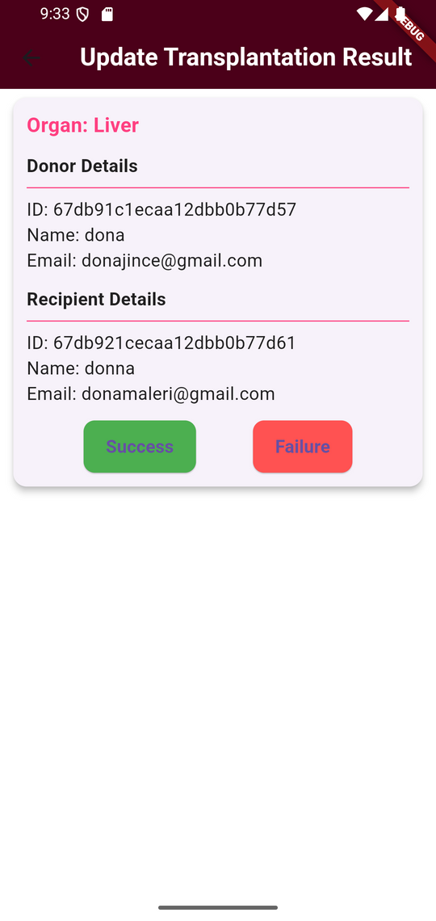
Update Transplantation Result

Slide 78
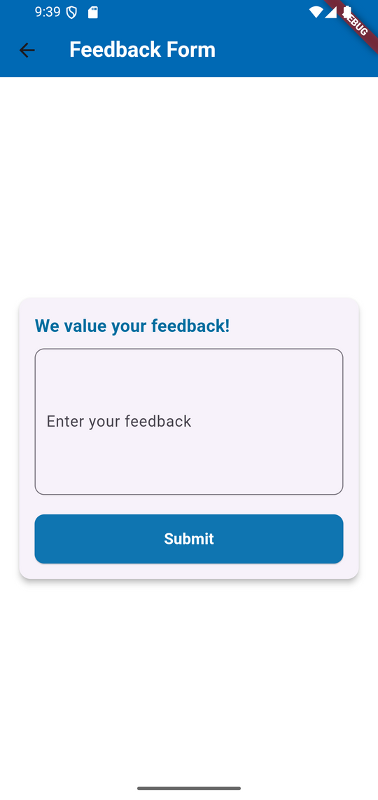
Submit Feedbacks

Slide 79
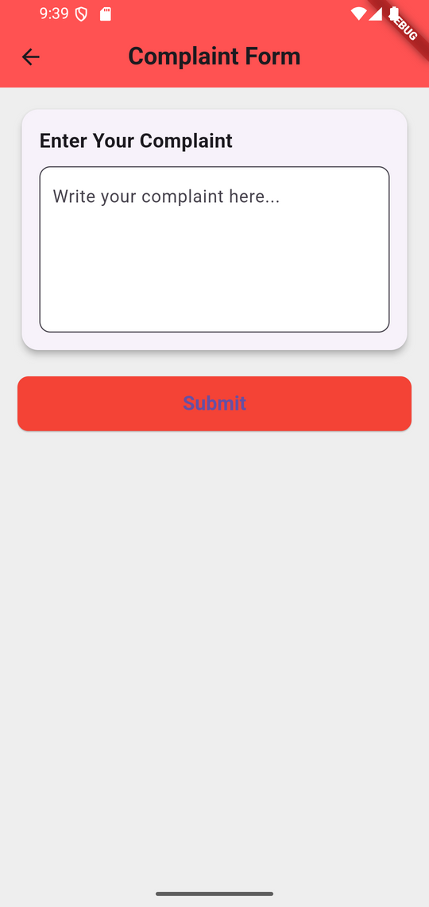
Submit Complaint

Slide 80
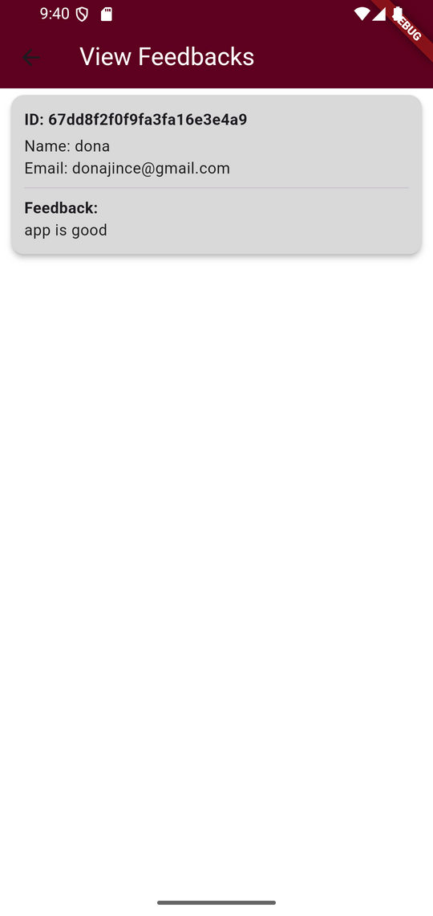
View Feedbacks

Slide 81
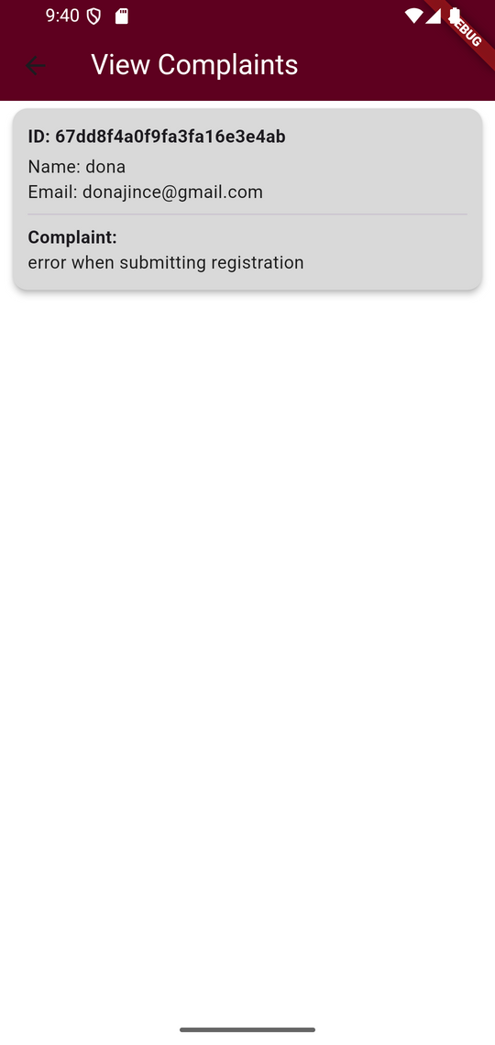
View Complaints

Slide 82
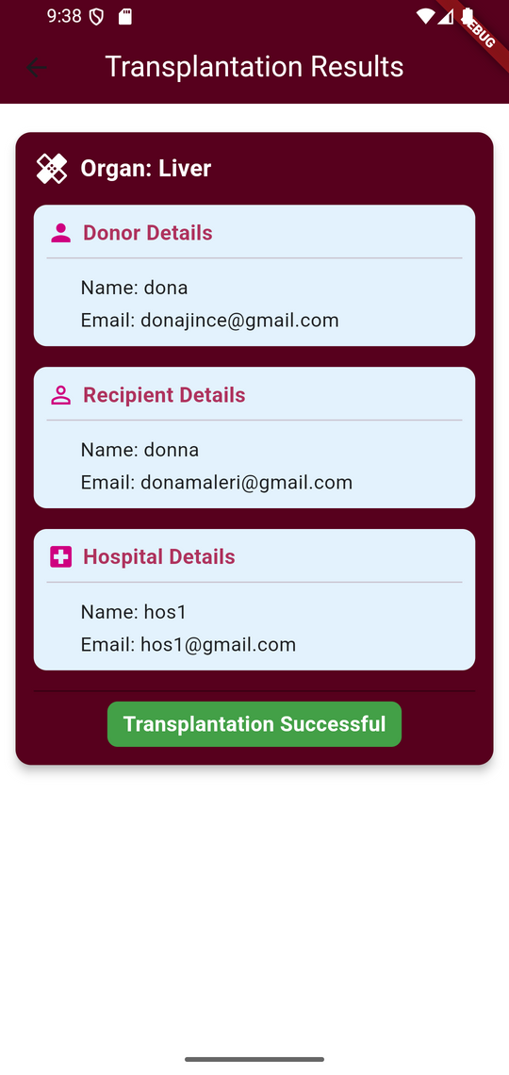
View Transplantation data

Slide 83
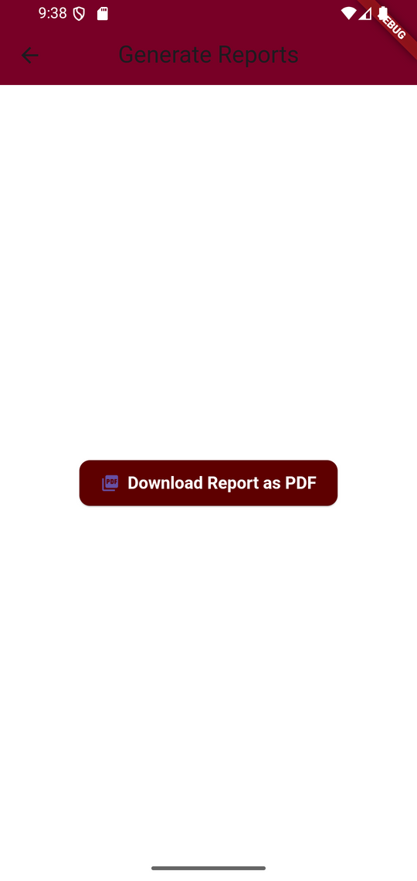
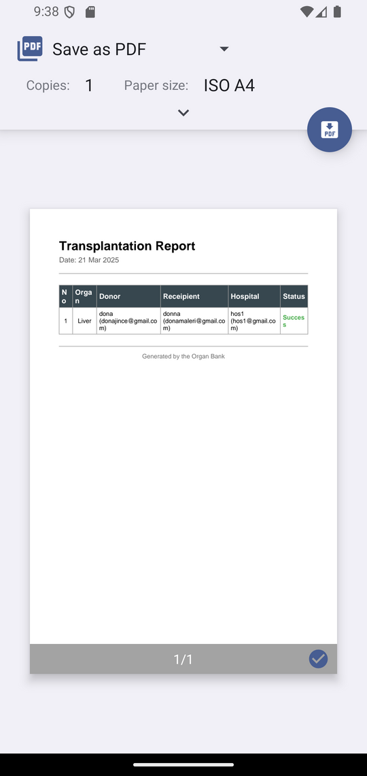
Generate Reports

Slide 84
DATABASE
DESIGN

Slide 85
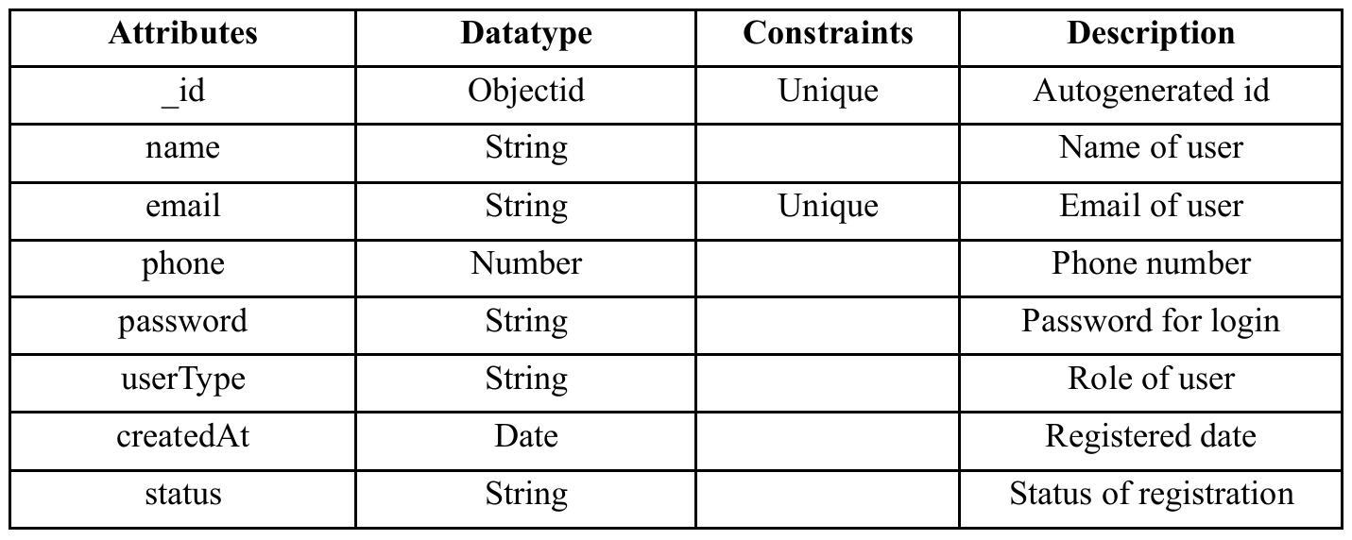
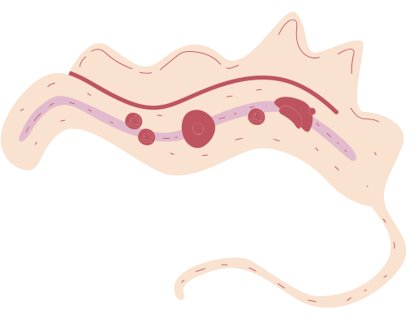
1. User

Slide 86

2. Donor

Slide 87

3. Receipient

Slide 88

4. Admin

Slide 89

5. Hospital

Slide 90

6. Donated_Organs

Slide 91

7. Requested_organs

Slide 92

8. Matched_organs

Slide 93

9.Transplantation

Slide 94

10. Feedback

Slide 95

11. Complaint

Slide 96
Thank you!

Slide 97
TESTING

Slide 98

Unit Testing

Slide 99



Slide 100


Slide 101


Slide 102



Slide 103

Integration Testing

Slide 104


Slide 105


Slide 106

Backend Testing

Slide 107


Slide 108


Slide 109


Slide 110

GUI Testing

Slide 111



Slide 112


Slide 113
GIT HISTORY

Slide 114


Slide 115


Slide 116


Slide 117



Thank you!

